Slide 1
Name
_ _ _ _ _ _ _ _ _ _ _ _ _ _ _ _ _
My Mission Log
Stop the Spread

Slide 2
Changemaker Profile
My Changemaker Selfie
Curiosity in Four PIctures
How do you show curiosity in life? What are you curious about?
Draw, write or add pictures about four things that make you curious in the four boxes below.

Slide 3
Contents
 | Mission Activities | Page
Mission | Module 1.1: Your Mission - KWL Chart | 4
Habit | Module 2.1: Explore - Glitter Activity | 6
 | Module 2.2: Explore - Habit Reflection | 7
Explore | Module 3.2: Vocabulary Activity | 9
 | Module 3.3: How does disease spread? | 11
 | Module 3.4: Climate Change Activity | 13
 | Module 3.5: How can climate change spread diseases? | 15
 | Module 3.6: Covid-19 Activity | 17
 | Module 3.7: How can we fight disease spread? | 18
 | Module 3.8: Making a model virus | 21
 | Module 3.9: How can we help? | 22
 | Module 3.10: Climate Change Schedule | 24
 | Module 3.11: Action Tags | 25
 | Module 3.12: You Decide - Debate Prep | 27
Take Action | Module 4.2: Pathos, Logos, Ethos | 31
 | Module 4.3 How can we use curiosity? | 32
 | Module 4:4 Planning time! | 33
Reflect | Module 5:1 What did you learn? | 37

Slide 4
2.1 K.W.L Chart
Directions: Take a minute to think about what you know about disease spread. Complete the K and W part of the chart. You will come back to the L later.
K
What do I already know about the topic
W
What do I want to know about the topic?
L
What have I learned?

Slide 6
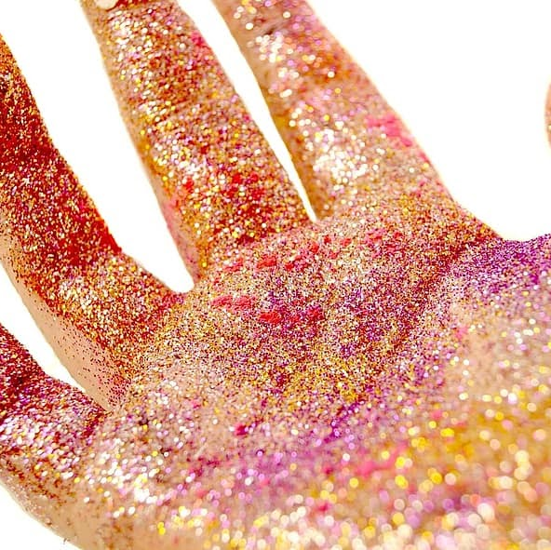
3.1 Glitter Challenge
Curiosity is all about asking questions. Asking questions is a great way to learn. There are lots of questions we can ask about disease and about the climate.
For example: Why do people say you should wash your hands to stop the spread of Covid-19? Let’s find out by taking the Glitter Germ Challenge. Follow the steps!
Gather your Materials. You will need…
Glitter tube (or sand or flour).
Access to a sink with hand soap.
A partner.
Find the glitter tube in your box. Then find a place where you can use glitter (not on the carpet)!
Wet your hands a little bit.
Put glitter on your hand so it covers your palm.
Shake hands with someone. See what happens to the glitter. Does it stay on your hand or spread to the other person’s hand?
Try to wipe the glitter off your hands? Does it wipe off?
Now wash your hands really well with soap. What happens to the glitter?
Now pretend the glitter were germs. What did this teach you about the importance of washing your hands to stop the spread of germs?
Curiosity: “We seek to ask and answer questions!

Slide 7
3.1 Habit Reflection
What is one example of how you have shown curiosity in the past?
2) What is one way you want to grow in your curiosity?

Slide 9
3.2 Vocabulary
Directions: Cut out the orange images below and match them with the correct vocab word. Then write a sentence for each word in the gray square.
disease
n. A condition that causes harm to a living thing. A sickness.
vector
n. An organism that carries disease.
Climate
n. The usual weather conditions in a place over time.
n. Being able to resist a disease.
immunity
n. A plant-like living thing that cannot make its own food.
fungi
n. Tiny living organisms with only one cell.
bacteria

Slide 11
3.3 What causes disease spread?
Directions: Note-taking time! Use the questions below to help you write down important details and evidence from the text that will help you with our project!
What are the most important ideas or parts of the text?
2) What did you find confusing?

Slide 12
3) How does this connect to other parts of what you read or what you know?
4) What information have you learned that could be helpful to your “Take Action” project (advertising campaign)?
5) What have you learned about the life habit of curiosity?

Slide 13
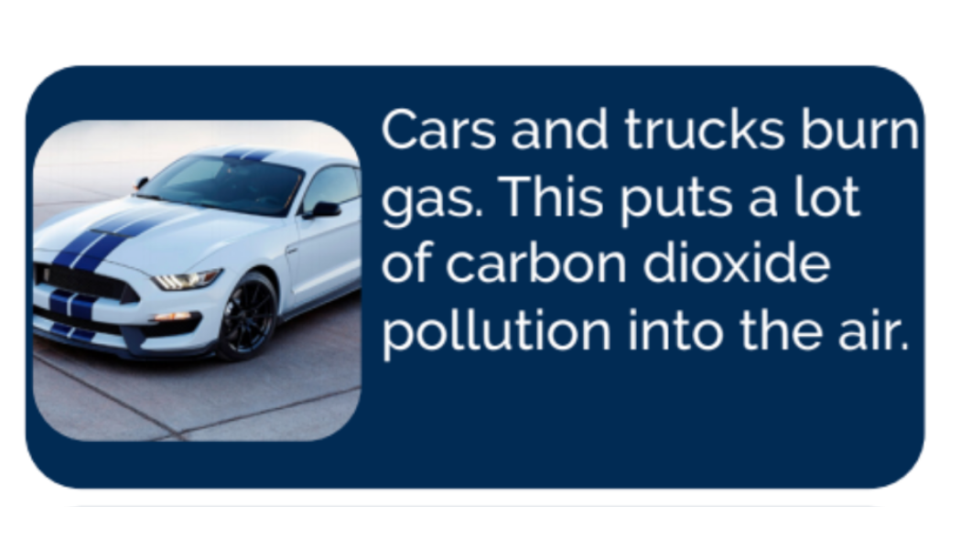
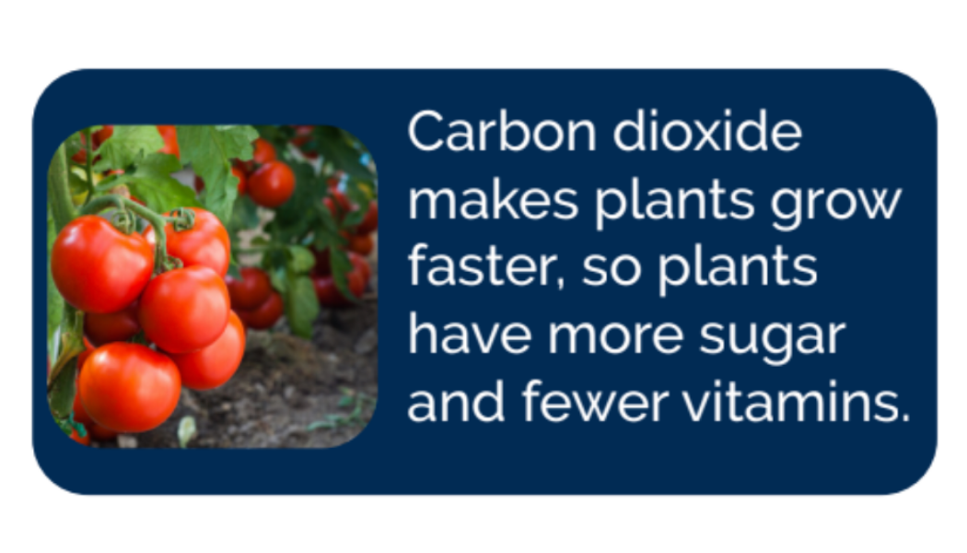
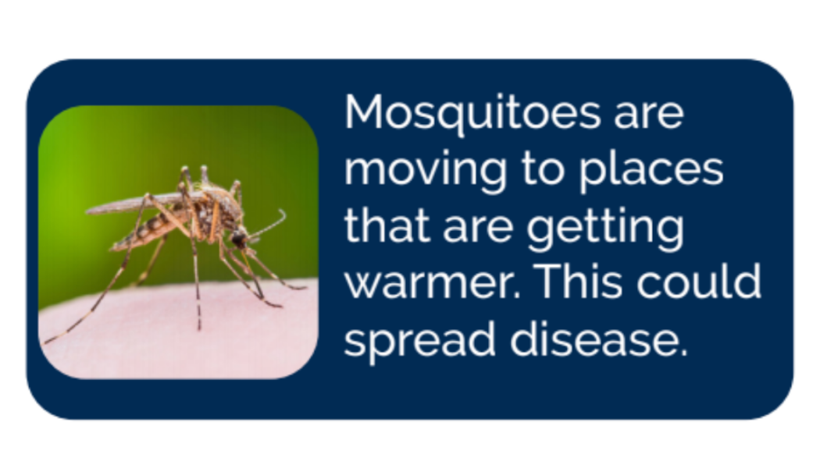
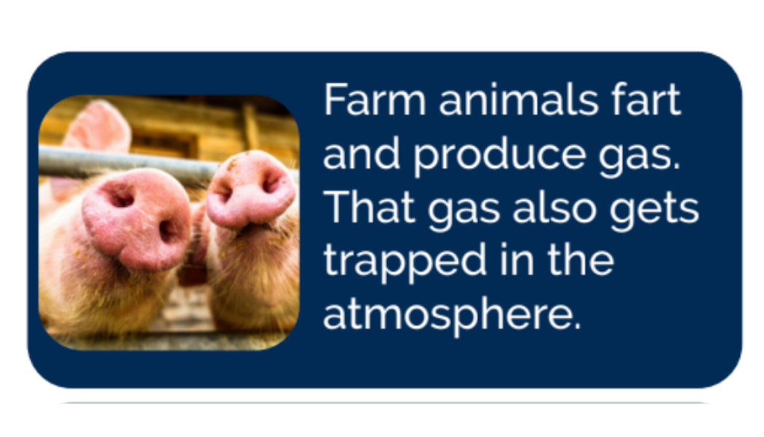
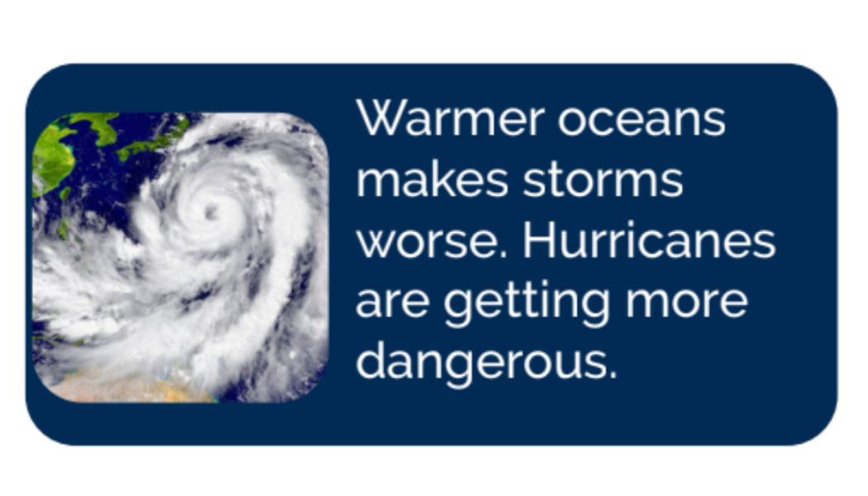
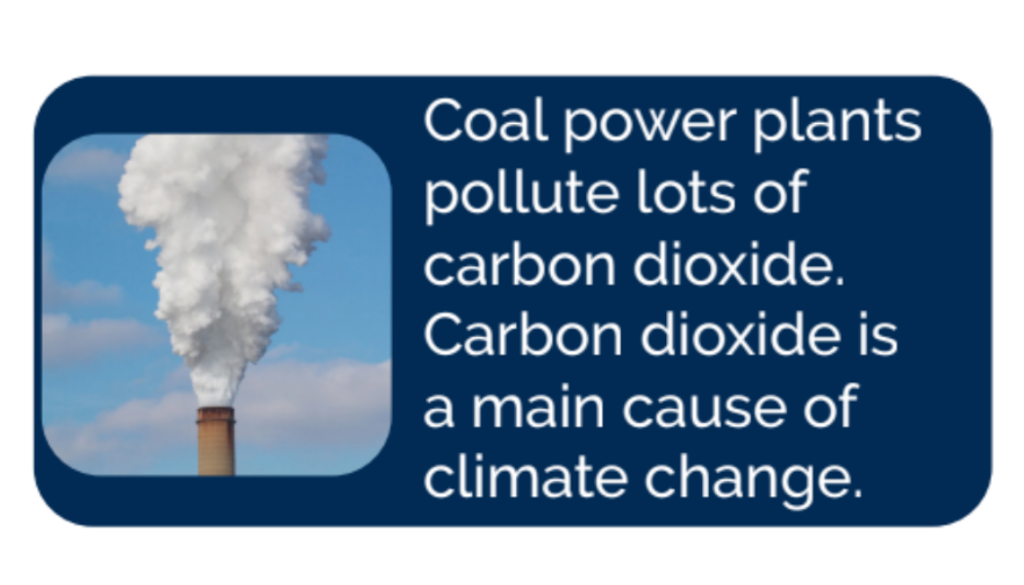
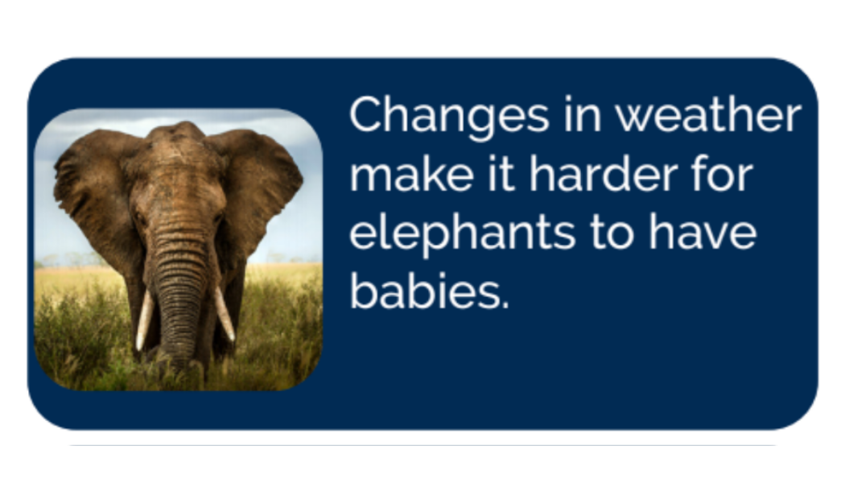
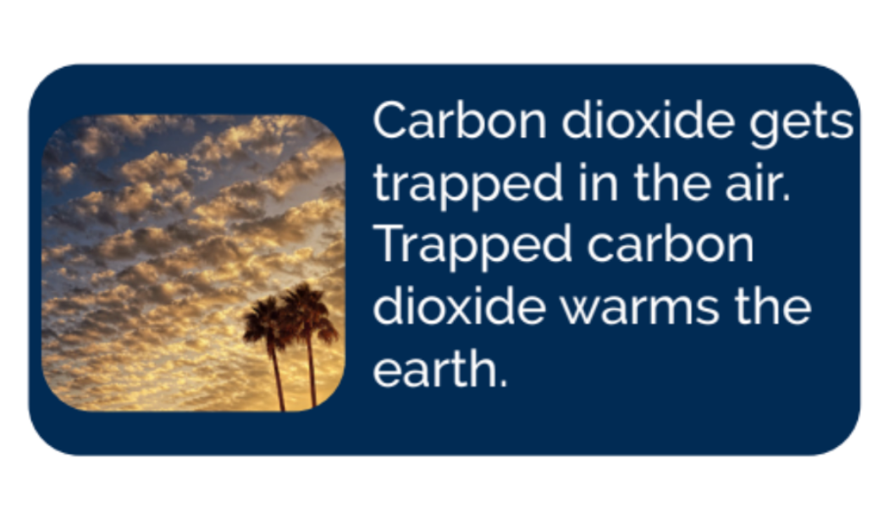
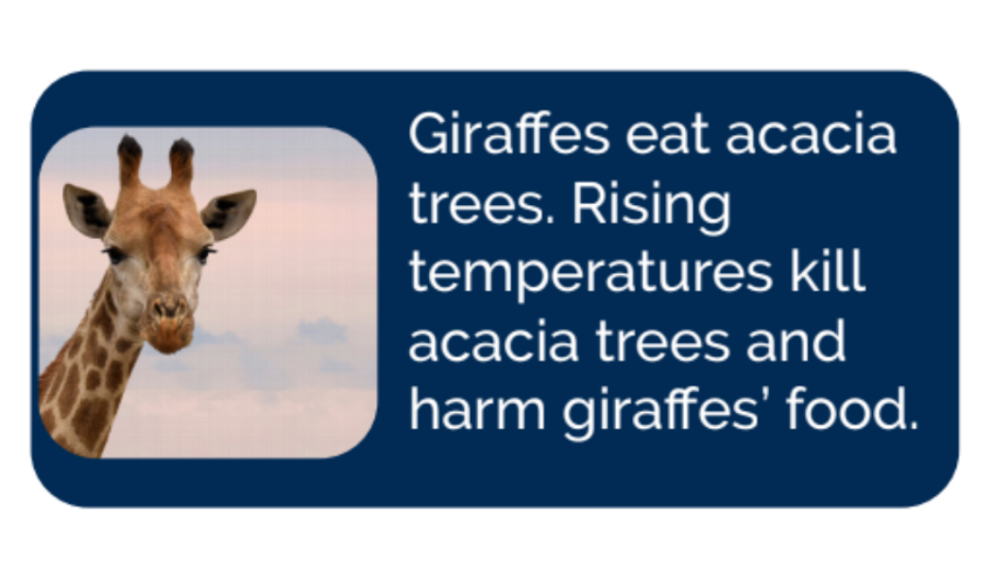
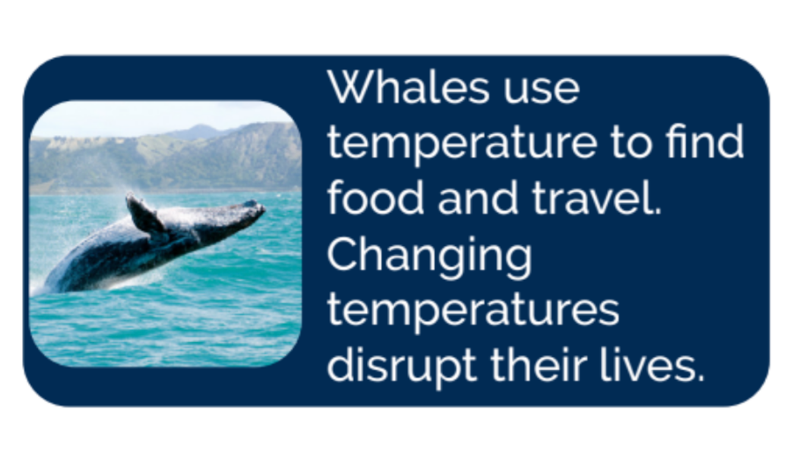
3.4 Cause & Effect
Directions: Cut out the cards below. If a card describes a cause of climate change, place it in the cause column. If it describes an effect, place it in the effect column.

Slide 15
3.5 How can climate change spread disease?
Directions: Note taking time! Use the questions below to help you write down important details and evidence from the text that will help you with our project!
What are the most important ideas or parts of the text?
2) What did you find confusing?
Answer Key From Page 12.

Slide 16
3) How does this connect to other parts of what you read or what you know?
4) What information have you learned that could be helpful to your “Take Action” project?
5) What have you learned about the life habit of curiosity?

Slide 17
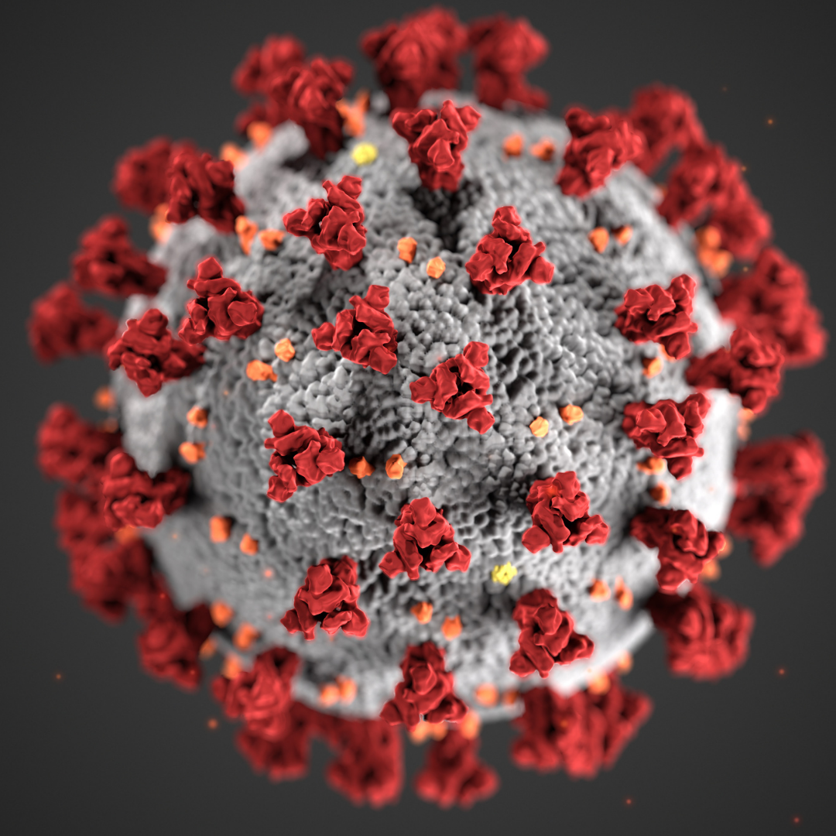
3.6 Covid-19 Show what you know
Directions: Answer as many questions as you can. You might not know the answers yet. That’s okay. The next video will help you learn more.
1. What kind of disease is covid-19?
2. What is the vector for Covid-19?
3. What are all the symptoms of Covid-19?
4. List all the ways you can protect yourself from Covid-19.

Slide 18
3.7 How can we fight disease spread?
Directions: Note-taking time! Use the questions below to help you write down important details and evidence from the text that will help you with our project!
What are the most important ideas or parts of the text?
2) What did you find confusing?

Slide 19
3) How does this connect to other parts of what you read or what you know?
4) What information have you learned that could be helpful to your “Take Action” project?
5) What have you learned about the life habit of curiosity?

Slide 20
Extend: Did you see any great tips of strategies in the “Kids Against Malaria” video you want to remember that can help you with your advertising campaign? Write your ideas below.

Slide 21
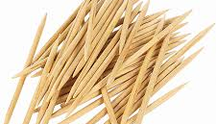
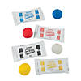
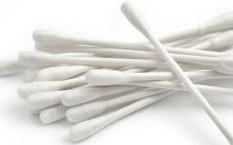
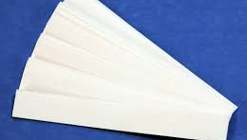
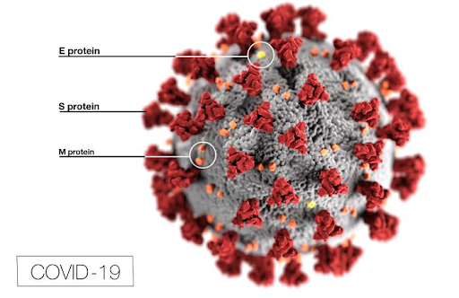
3.8 Immunity: Making A Model Virus
Scientists make models to communicate their ideas, understand processes, and make predictions. Making a model virus helped scientists to understand the parts of the virus and how it works. In order to create a vaccine you need to understand the virus by modeling and predicting what it could do using models.
Toothpicks
Model Magic
Q-Tips
Paper labels
Directions:
Study the picture of the Coronavirus.
Recreate the virus noting some key features of the virus. Use the toothpicks and Q tips. You could color the Q-tips to show the different proteins.
Label the different parts of the virus. Using the label stickers around the Q-tips.

Slide 22
3.9 How can we help?
Directions: Note taking time! Use the questions below to help you write down important details and evidence from the text that will help you with our project!
What are the most important ideas or parts of the text?
2) What did you find confusing?

Slide 23
3) How does this connect to other parts of what you read or what you know?
4) What information have you learned that could be helpful to your “Take Action” project?
5) What have you learned about the life habit of curiosity?

Slide 24
3.10 Climate Change Schedule
Directions: How can you make a difference? Complete the schedule below with ideas on how you think you could help reduce climate change with the small actions you take each day. Write what steps you can take to stop climate change in the “What I do” column. Explain how those steps help in the ‘How I help” column.
Time of Day
What I do
How I help
Morning Before School
...
...
During School
...
...
After school
...
...
Before Bed
...
...

Slide 25
3.11 Action Tags
Do you ever forget to do things? We forget things all the time. Remembering can be hard. It’s also really hard to change habits. If you never turn out the light, it will be hard to remember to start turning it off every time.
You’ll make 5 action tags to help you remember important actions to help stop climate change and stop the spread of disease. You can hang them in your home. Every time you see a tag they’ll remind you what to do.
Make a list of the 5 actions you want to remember to take. They can be from the daily schedule on the back of your zine. They can also be other ways you want to help stop the spread of disease. Make your list below.
1.
2.
3.
4.
5.

Slide 26
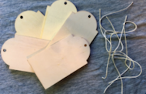
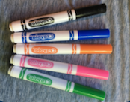
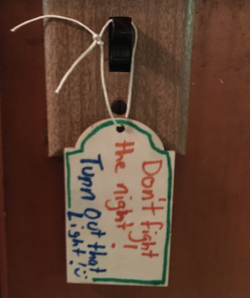
Time To Rock It Out!
Gather Materials
You are now going to make your reminder tags. You should make one tag for each action. You have five tags for five actions! You want your tags to look nice and stand out. You can use words or pictures or both. You can even make fun rhymes! You can use one side of the tag
or both sides! Be creative.
Directions:
1. Find your five action tags.
2. Make one action tag for each
action.
3. Tie the string to your action
tag.
4. Hang your action tags around
your home.
Pro-Tip
When people see interesting things they get curious. Make your tags as interesting as possible so you and your family pay attention to them.

Slide 27
3.12 You Decide-
Debate Prep
Directions: Use the table below to help you prepare for the debate. Remember to look back at the Zine to find evidence for your side.
Write in which side you will be taking for the debate:
Write your Opening Statement (3 min). Bullet out your 2-3 key points.
Rebuttal - Think about what your opponents may say and come up with 2-3 rebuttal statements.
Opponent’s Argument #1:
Your Rebuttal #1:

Slide 28
Opponent’s Argument #2:
Your Rebuttal #2:
Opponent’s Argument #3:
Your Rebuttal #3:
Closing Statement: Summarize your most important points.

Slide 30
4.1 Think About It
Directions: Some ads make us curious. We see them and think, “Huh! I want
to learn more!” Can you think of any ads you’ve seen that made you curious?
1.
2.
3.
4.
5.

Slide 31
4.2 Logos,
Pathos, Ethos
Directions: Now you try. Pretend you want to convince everyone you know that they should wash their hands to help stop the spread of disease. How can you make ads that make them feel, make them think and make them trust? Try to make one ad for each include a picture and a catchy question.
Pathos
Logos
Ethos

Slide 32
4.3 How can we use curiosity?
Directions: Which message piques your curiosity the most? One way to think about this is which title would you click on first if you saw it online and why? Rank from 1-5, one being the most curious and five being the least curious. Cut out the numbers below to rank or write the numbers in each circle.
Can the Corona virus kill animals?
Top 10 ways to keep your family active during quarantine.
Which Covid-19 vaccine is most effective?
Is it better to wear a mask or socially distance?
When can I get a vaccine?
Discuss and explain your answers with a partner or with your group.
1
2
3
4
5

Slide 33
4.4 Planning Time!
Plan your message & Visuals

Slide 34
Plan your Image
You have an action. You know what you want people to do. You also have a question. You know how you will make people curious so they will read your card.
Now it’s time to pick an image. What picture can you draw on the cover of your postcard? Your image should stand out and make people excited to read your postcard.
Remember. Your magic postcard advertisement is a “scratch-off.” Your image should be something you can scratch with your stick!

Slide 35
Write your note
Now it’s time to plan the note on the back of your magic postcard advertisement.
Your note should answer the question on the front of your card by:
What: Teaching people about your action.
Why: Telling people why that action matters.
Thanks: Thanking them for helping.
Refer back to the module 4-2 to read an example of a note.

Slide 37
5.1 What did you learn?
Write your own individual reflections below
1) What did you learn about how you can make an impact?
2) What did you learn about yourself as a leader?
3) What did you learn about the life habit curiosity?
4) What is one goal you want to set around using curiosity moving forward?

